Slide 1
Computer Science II Advanced C++
Spring 2019

Slide 2
Classes in C++
Inheritance between classes

Slide 3
Useful Links to C++ tutorial
There are some useful hints and illustrations on classes in C++ at
http://www.cplusplus.com/doc/tutorial/classes/
on friendship and inheritance
http://www.cplusplus.com/doc/tutorial/inheritance/

Slide 4
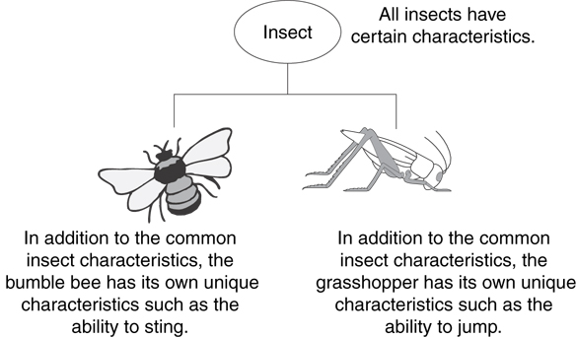
Example: Insects

Slide 5
The "is a" Relationship
Inheritance establishes an "is a" relationship between classes.
A poodle is a dog
A car is a vehicle
A flower is a plant
A football player is an athlete

Slide 6
Inheritance as a concept
Classes in C++ can be extended, creating new classes which retain characteristics of the base class. This process, known as inheritance, involves a base class and a derived class: The derived class inherits all members of the base class , on top of which it can add its own members
For example, let's imagine a series of classes to describe two kinds of polygons: rectangles and triangles. These two polygons have certain common properties, such as the values needed to calculate their areas: they both can be described simply with a height and a width (or base).

Slide 7
Inheritance as a concept
Classes Rectangle and Triangle are derived from the Polygon class
The Polygon class would contain members that are common for rectangles and triangles: width and height.
Rectangle and Triangle would be its derived classes, however with their own specific features that are different from one type of polygon to the other
Class Polygon
Class Rectangle
Class Triangle

Slide 8
Inheritance – Terminology and Notation
Base class (or parent) – inherited from
Derived class (or child) – inherits from the base class
Notation:
class Student // base class
{
. . .
};
class UnderGrad : public student
{ // derived class
. . .
};

Slide 9
Back to the ‘is a’ Relationship
An object of a derived class 'is a(n)' object of the base class
Example:
an UnderGrad is a Student
a Mammal is an Animal
A derived object has all of the characteristics of the base class

Slide 10
What Does a Child Have?
An object of the derived class has:
all members defined in child class
all members declared in parent class
An object of the derived class can use:
all public members defined in child class
all public members defined in parent class

Slide 11
15.2
Protected Members and Class Access

Slide 12
Protected Members and Class Access
private member access specification means inaccessibility by objects of derived (child) class
protected member access specification: like private, but accessible by objects of derived class
Class access specification: determines how private, protected, and public members of base class are inherited by the derived class

Slide 13
Class Access Specifiers
public – object of derived class can be treated as an object of base class (not vice-versa)
protected – more restrictive than public, but allows derived classes to know details of parents
private – prevents objects of derived class from being treated as objects of base class

Slide 14
Inheritance vs. Access
How inherited base class members
appear in derived class
Base class members
private: x
protected: y
public: z
private
base class
x is inaccessible
private: y
private: z
private: x
protected: y
public: z
protected
base class
x is inaccessible
protected: y
protected: z
private: x
protected: y
public: z
public
base class
x is inaccessible
protected: y
public: z

Slide 15
More Inheritance vs. Access
class Grade
class Test : public Grade
private members:
char letter;
float score;
void calcGrade();
public members:
void setScore(float);
float getScore();
char getLetter();
private members:
int numQuestions;
float pointsEach;
int numMissed;
public members:
Test(int, int);
private members:
int numQuestions:
float pointsEach;
int numMissed;
public members:
Test(int, int);
void setScore(float);
float getScore();
char getLetter();
When Test class inherits
from Grade class using
public class access, it looks like this:

Slide 16
More Inheritance vs. Access (2)
class Grade
class Test : protected Grade
private members:
char letter;
float score;
void calcGrade();
public members:
void setScore(float);
float getScore();
char getLetter();
private members:
int numQuestions;
float pointsEach;
int numMissed;
public members:
Test(int, int);
private members:
int numQuestions:
float pointsEach;
int numMissed;
public members:
Test(int, int);
protected members:
void setScore(float);
float getScore();
float getLetter();
When Test class inherits
from Grade class using
protected class access, it looks like this:

Slide 17
More Inheritance vs. Access (3)
class Grade
class Test : private Grade
private members:
char letter;
float score;
void calcGrade();
public members:
void setScore(float);
float getScore();
char getLetter();
private members:
int numQuestions;
float pointsEach;
int numMissed;
public members:
Test(int, int);
private members:
int numQuestions:
float pointsEach;
int numMissed;
void setScore(float);
float getScore();
float getLetter();
public members:
Test(int, int);
When Test class inherits
from Grade class using
private class access, it looks like this:

Slide 18
Exercise on Inheritance
Design the following family of classes and test them
Class Polygon
#width: int
#height: int
+set_values(a:int,b:int):void
Class Rectangle
public Polygon
+area():int
public
public
public
Class Triangle
public Polygon
+area():int
Class Square
public Rectangle
+Square(side:int)

Slide 19
15.3
Constructors and Destructors in Base and Derived Classes

Slide 20
Constructors and Destructors in Base and Derived Classes
Derived classes can have their own constructors and destructors
When an object of a derived class is created, the base class’s constructor is executed first, followed by the derived class’s constructor
When an object of a derived class is destroyed, its destructor is called first, then that of the base class

Slide 21
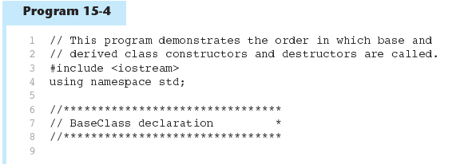
Constructors and Destructors in Base and Derived Classes

Slide 22
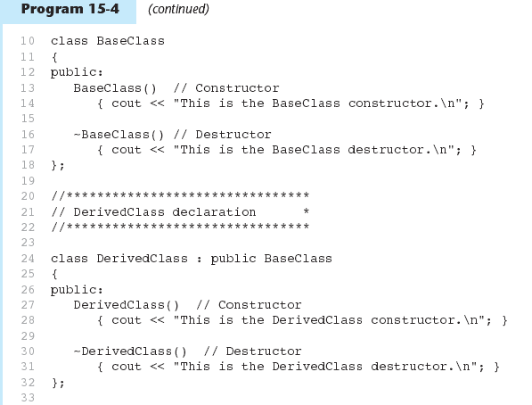

Slide 23
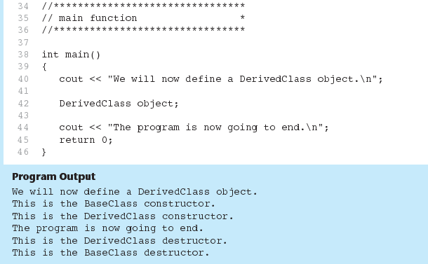
Program 5-14 (Continued)

Slide 24
Passing Arguments to Base Class Constructor
Allows selection between multiple base class constructors
Specify arguments to base constructor on derived constructor heading:
Square::Square(int side) : Rectangle(side, side)
Can also be done with inline constructors
Must be done if base class has no default constructor

Slide 25
Passing Arguments to Base Class Constructor
derived class constructor
base class constructor
Square::Square(int side):Rectangle(side,side)
derived constructor parameter
base constructor parameters

Slide 26
Example of Parent/Child Classes
// derived classes
#include <iostream>
using namespace std;
class Polygon // Parent class
{
protected:
int width, height;
public:
void set_values (int a, int b) // this function is public and
{ width=a; height=b;} // will be inherited by child classes
};
class Rectangle: public Polygon // Child class of Polygon
{
public:
int area () // function area for Rectangle
{ return width * height; } // width and height are inherited from Polygon
};
class Triangle: public Polygon // Child class of Polygon
{
public:
int area () // // function area for Triangle
{ return width * height / 2; }
};
int main ()
{
Rectangle rect; // object rect
Triangle trgl; // object trgl
rect.set_values (4,5); // set rect param.
trgl.set_values (4,5); // set trgl param.
cout << rect.area() << '\n'; //rect. area
cout << trgl.area() << '\n'; //trgl. area
return 0;
}

Slide 27
What is not inherited from the base class?
its constructors and its destructor
its friends
Even though access to the constructors and destructor of the base class is not inherited as such, they are automatically called by the constructors and destructor of the derived class
Unless otherwise specified, the constructors of a derived class call the default constructor of its base classes (i.e., the constructor taking no arguments). Calling a different constructor of a base class is possible, using the same syntax used to initialize member variables in the initialization list: derived_constructor_name (parameterList) : base_constructor_name (argumentList)

Slide 28
15.4
Redefining Base Class Functions

Slide 29
Redefining Base Class Functions
Redefining function: function in a derived class that has the same name and parameter list as a function in the base class
Typically used to replace a function in base class with different actions in derived class

Slide 30
Redefining Base Class Functions
Not the same as overloading – with overloading, parameter lists must be different
Objects of base class use base class version of function; objects of derived class use derived class version of function

Slide 31
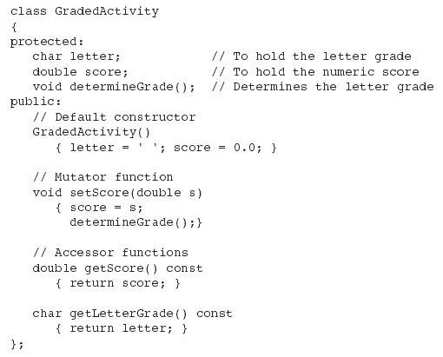
Base Class
Note setScore function

Slide 32

Derived Class
Redefined setScore function

Slide 33
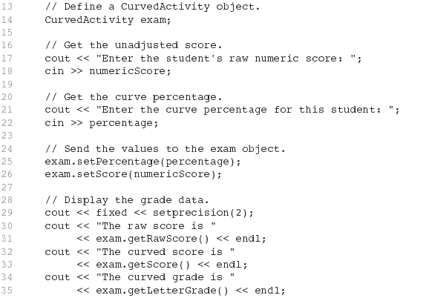

From Program 15-7

Slide 34
Problem with Redefining
Consider this situation:
Class BaseClass defines functions x() and y(). x() calls y().
Class DerivedClass inherits from BaseClass and redefines function y().
An object D of class DerivedClass is created and function x() is called.
When x() is called, which y() is used, the one defined in BaseClass or the the redefined one in DerivedClass?

Slide 35
Problem with Redefining
BaseClass
Object D invokes function X()in BaseClass
Function X() invokes function Y() in BaseClass and not function Y()in DerivedClass
Function calls are bound at compile time.
This is static binding.
void X();
void Y();
DerivedClass
void Y();
DerivedClass D;
D.X();

Slide 36
15.5
Class Hierarchies

Slide 37
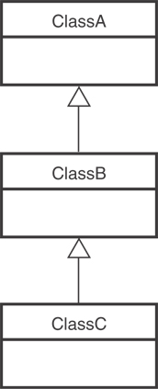
Class Hierarchies
A base class can be derived from another base class.

Slide 38
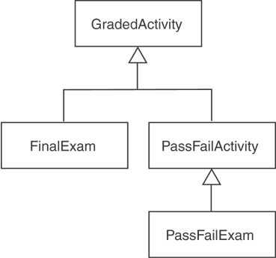
Class Hierarchies
Consider the GradedActivity, FinalExam, PassFailActivity, PassFailExam hierarchy in Chapter 15.

